Slide 1
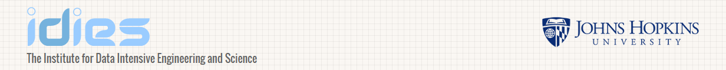

IDIES Annual Symposium 2016
The ‘Sixth’ Factor – Social Media Factor Derived Directly from Tweet Sentiments
Presented by Jim Kyung-Soo Liew, Ph.D.
Assistant Professor in Finance
Where business is taught with humanity in mind.

Slide 2
Contents
Motivation
Research question
Investigations
Conclusions
Extensions

Slide 3
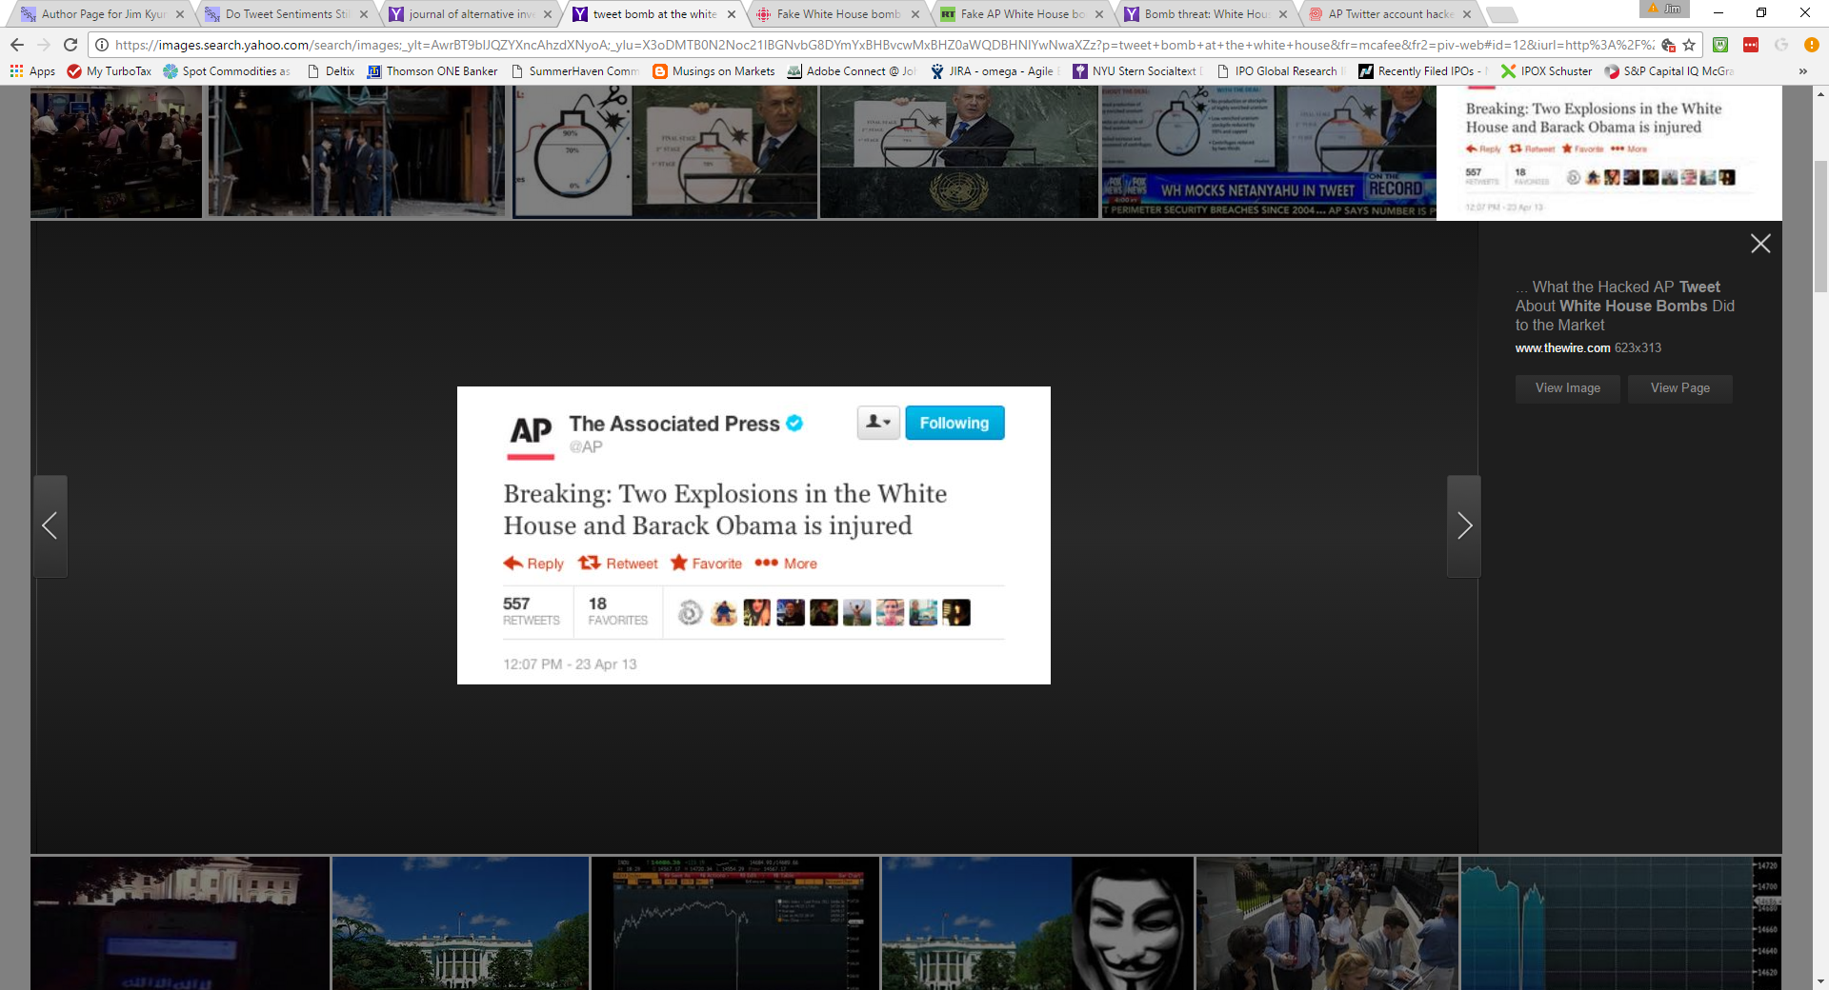
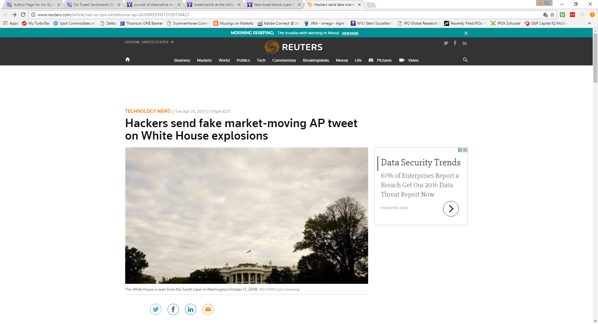
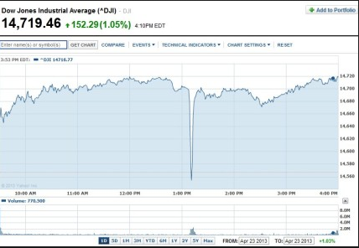
Motivation:
Social Media platforms (e.g. Facebook, Twitter, LinkedIn, YouTube, etc.) generate tremendous amounts of data
Anecdotal evidence shows that this “alternative” data source has influences on markets

Slide 4
Research question: Is there a link between social media information and security markets?

Slide 5
First investigation...failure.
In 2010, obtained StockTwits data set and asked NYU Stern MBAs to manually read tweets and classify them as either “+” or “-”, ~50 students x 100 tweets = total 5,000 label data.
Shipped “labeled” data to west coast startup that “trained” their classification models and labeled the rest of this data set
Took all the data to Baruch (Stat Arb) students and asked them to join with intra-day prices by stock and we analyzed the results
Conclusion – Tweet sentiments at that time was a weak contrarian indicator, not statistically significant. Ugh!

Slide 6
Second investigation
In 2015, obtained tweet sentiments data. Downloaded IPOs information from Bloomberg, e.g. day, offer price/performance (both contemporaneous and predictive relationships)
Sample included 300 IPOs
Conclusion -- Found statistically significant relationship between IPO returns (first-open to first-close) and contemporaneously tweet sentiments. Also, documented a predictive relationship between prior day’s tweet sentiments and IPO returns (first-offer to first-open).
Could we strengthen the results by examining more events?
Follow-on research:
Publicly listed companies must disclose financial results each quarter, “quarterly-earnings reports” 4x per year. Sample size +6k-8k
Examine Post-Earnings-Announcement-Drift (PEAD) well-known phenomenon in finance with many known variables contributing to explanation of “drift”
We tested tweet sentiments in the presence of traditional PEAD variables
Conclusion – Documented link between tweet sentiment and PEAD, found that negative tweet sentiment securities with positive earnings surprise generated significant excess returns for up to 15 days

Slide 7
Third break-through investigation!
“Twitter Sentiment and IPO Performance: A Cross-Sectional Examination” by Jim Liew and Garrett Wang, Journal of Portfolio Management, Summer 2016, Vol.42, No.4: pp. 129-135
“Tweet Sentiments and Crowd-Sourced Earnings Estimates as Valuable Sources of Information Around Earnings Releases” by Jim Liew, Shenghan Guo, and Tongli Zhang, forthcoming Journal of Alternative Investments 2017.
“The ‘Sixth’ Factor – Social Media Factor Derived Directly from Tweet Sentiments” by Jim Liew and Tamas Budavari, forthcoming Journal of Portfolio Management 2017. https://papers.ssrn.com/sol3/papers.cfm?abstract_id=2711825
“Do Tweet Sentiments Still Predict the Stock Market?” by Jim Liew and Tamas Budavari, forthcoming Alternative Investment Analyst Review 2017. https://papers.ssrn.com/sol3/papers.cfm?abstract_id=2820269

Slide 8
“The ‘Sixth’ Factor – Social Media Factor Derived Directly from Tweet Sentiments”

Slide 9
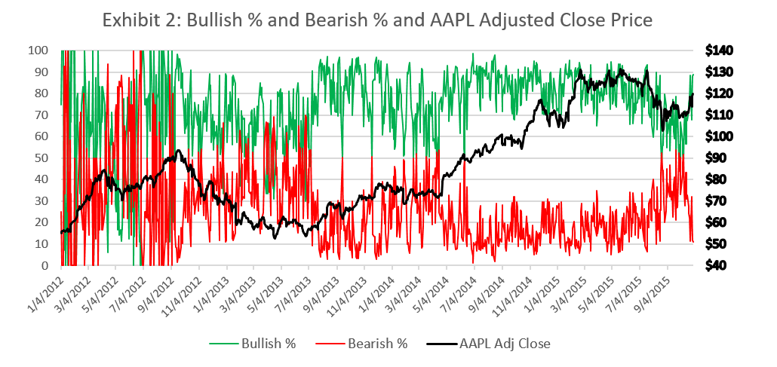
Bullish % and Bearish % constructed by counting the number of user-defined Bullish and Bearish tweets on “$AAPL” and dividing each by the total number.

Slide 10
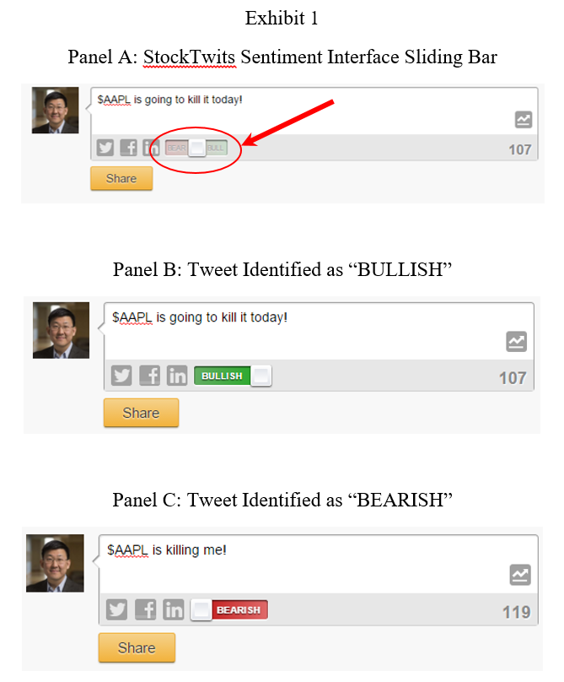
Methodology:
Took sample of stocks with high tweet volumes
Use the simplest measure of sentiment – User-defined “Bullish” or “Bearish” (Exhibit 1)

Slide 11
Methodology:
Took sample of stocks with high tweet volumes
Use the simplest measure of sentiment – User-defined “Bullish” or “Bearish” (Exhibit 1)
Construct a time-series based on all user-labeled tweets. Tweets intra-day time-stamps aggregated to daily frequency
Each stock has it’s own Social Media Factor (idiosyncratic) and run the following regression below
If t-statistics are above 2.0 then it’s statistically significant!
$$R_{i,t}−R_{f,t}=α+β∗\left(R_{m,t}−R_{f,t}\right)+s∗\left({SMB}_{t}\right)+h∗\left({HML}_{t}\right)$$
$$+r∗\left({RMW}_{t}\right)+c∗\left({CMA}_{t}\right)+p∗\left({SMF}_{i,t}\right)+ε_{i,t}$$

Slide 12
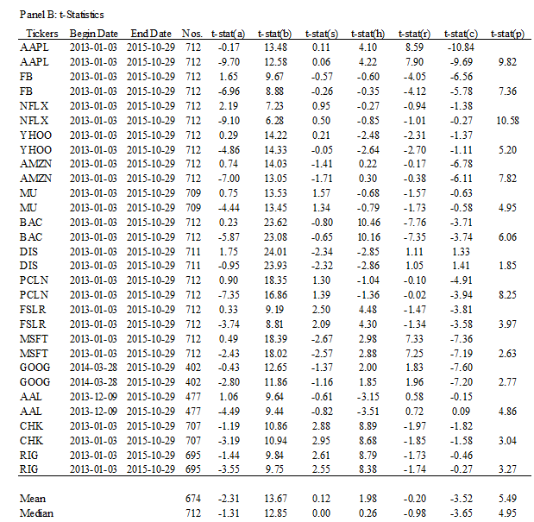
Looking for t-stats above 2.0 “t-stat(p)”

Slide 13
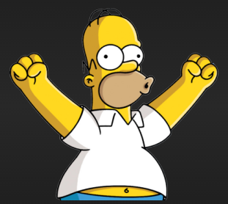
Looking for t-stats above 2.0 “t-stat(p)”
Yes!

Slide 14
Do Tweet Sentiments Still Predict the Stock Market?

Slide 15
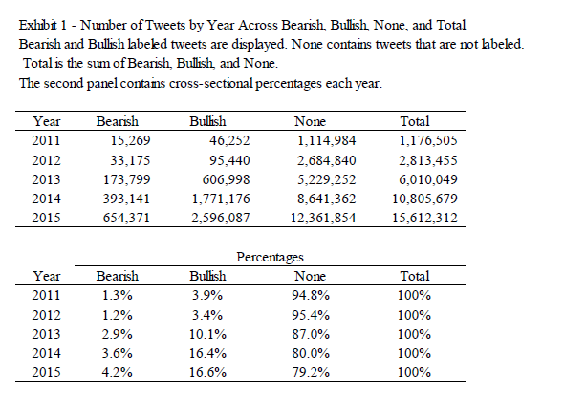
Exhibit 1 – Number of Tweets by Year
36 million tweets!

Slide 16
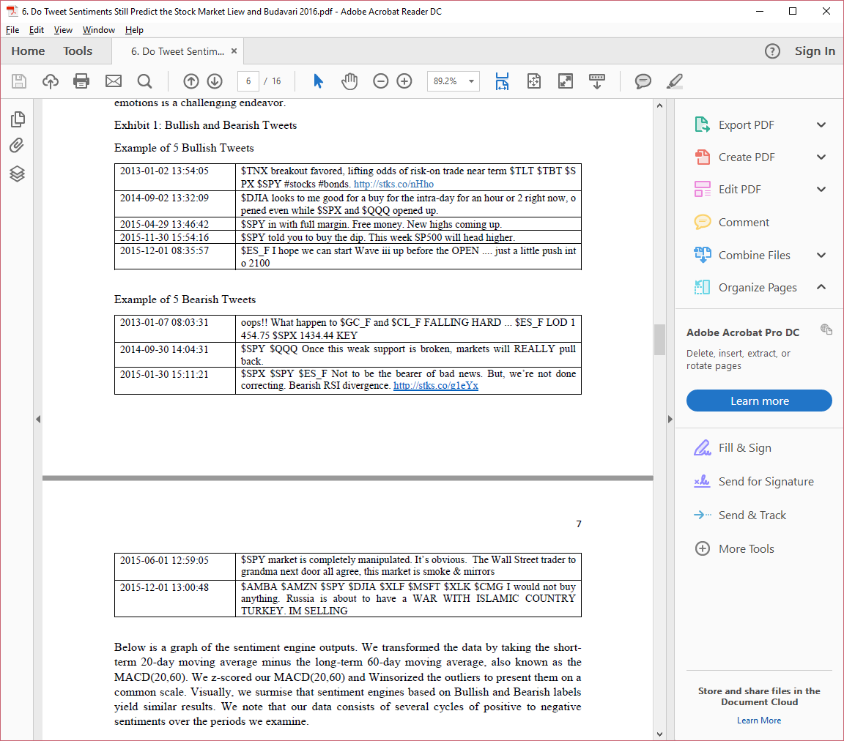
Examples of Bullish and Bearish Tweets

Slide 17
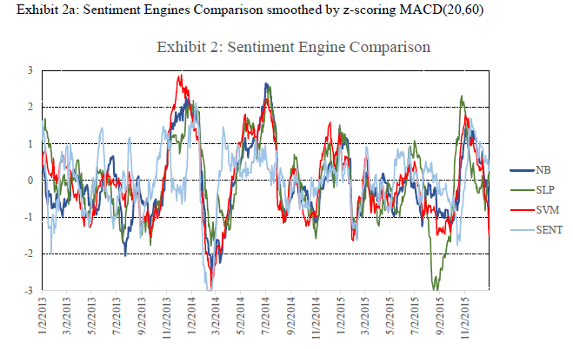
Exhibit 2: Sentiment Engine Comparison
NB – Naive Bayes, SLP – Single Layer Perceptron, SVM – Support Vector Machine, SENT – Pattern’s sentiment engine

Slide 18
Who’s driving?
Tweet sentiments vs Markets

Slide 19
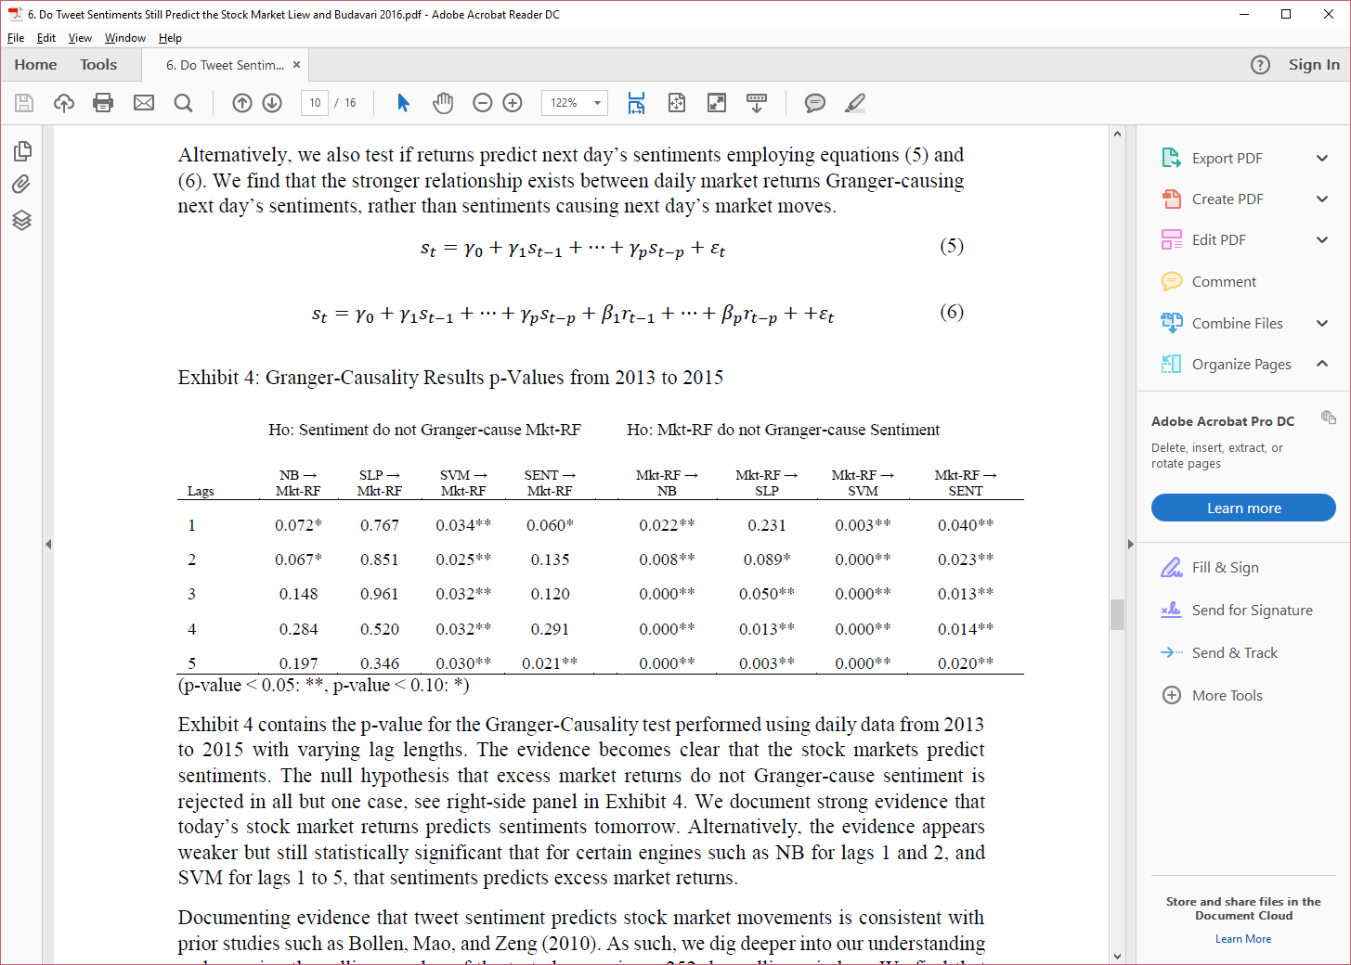
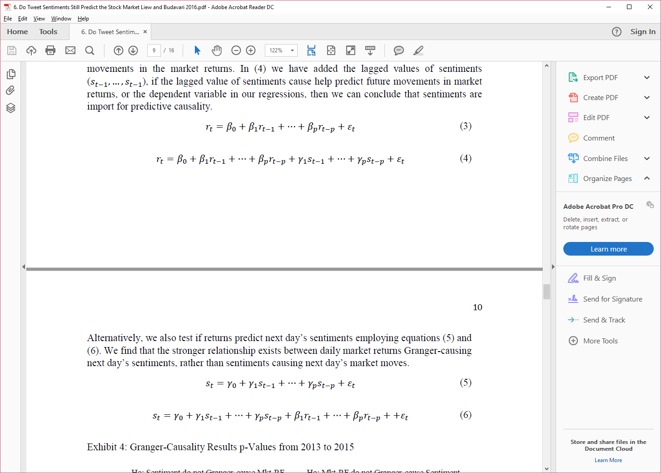
Who’s driving? Tweet sentiments vs Markets

Slide 20
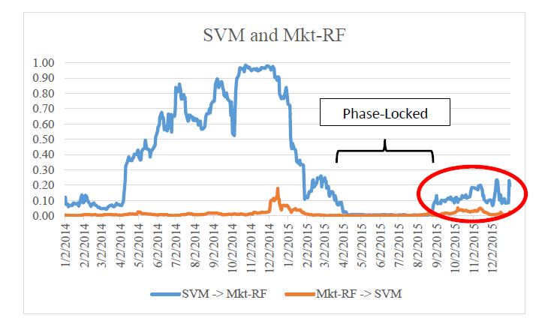
Let’s examine the rolling p-values... “Phase-Locked” period when tweet sentiments actually drove markets!

Slide 21
Conclusions
Finding links between equity price behavior around IPOs & earnings events and tweet sentiments gave us initial clues that something more substantial was lurking beneath the surface
Linking the daily time-series of a given stock returns to its contemporaneous tweet sentiments was a significant break-through contribution
Finally, documenting market-wide tweet sentiments “caused” markets to actually move gave hope for traders, but unfortunately the efficiency of the market prevailed. The trade is over!

Slide 22
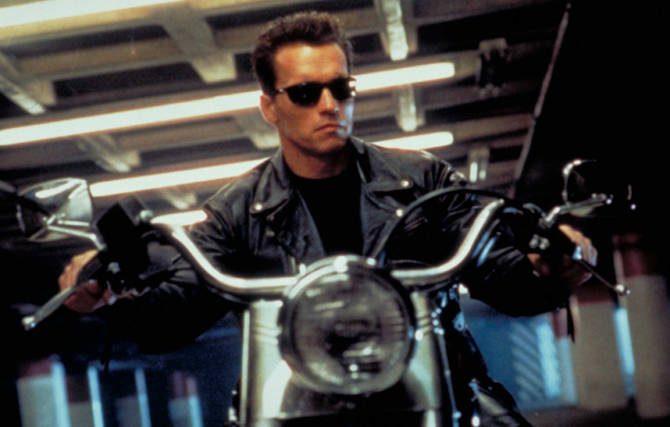
Extensions
Machine Learning has amazing tools that can be readily applied to finance (we’re offering “Big Data Machine Learning” at JHU Carey for the 1st time!)
How about building a FinTech AI that trades the markets? Attempts to beat human traders.
Mixing cross-collaboration, big data, huge computation resources, and domain expertise, results in explosive breakthroughs
Input data would include: graphs, news, text, pictures, videos, sentiments, geo-positions of information, fundamentals, technical, uncertainty, etc.
WARNING! WARNING! WARNING!
The Terminator is coming to trade against you!
But not any time soon.

Slide 23
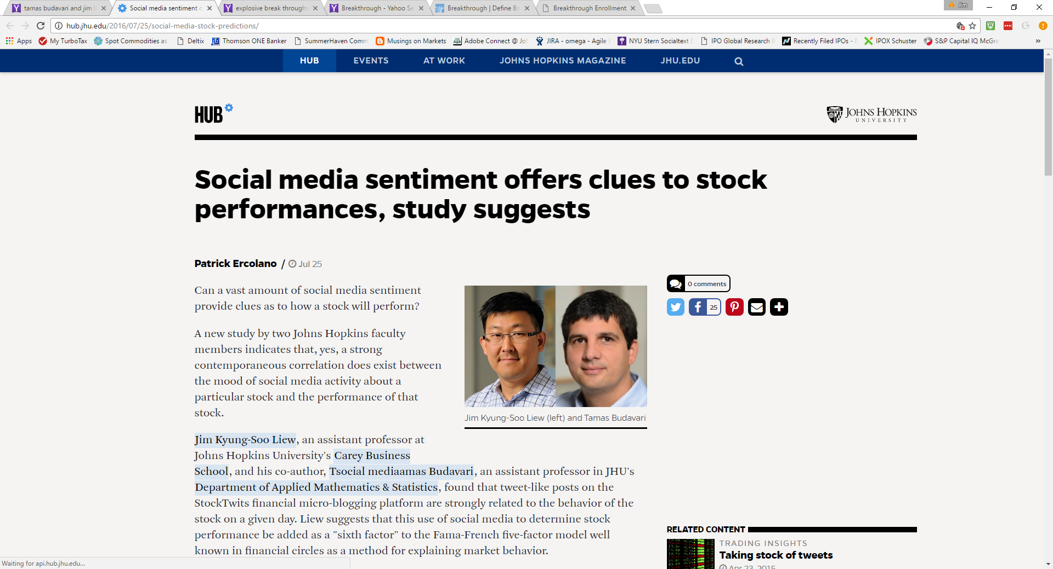
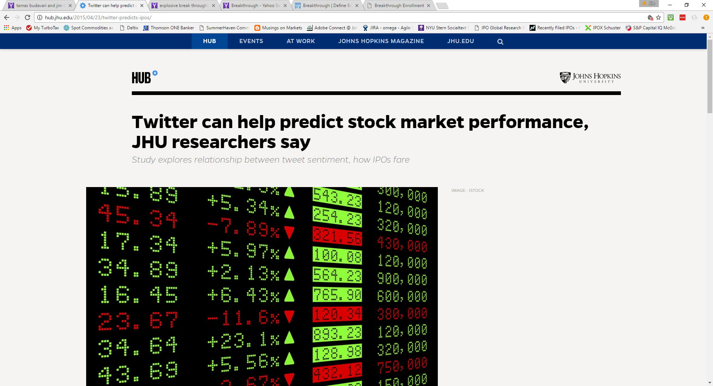
Thanks for your time!

